Slide 1
Scenario-Based Modeling Activity Diagram : Control Flow

Slide 2
Analysis Modeling Approaches
Structured analysis
Considers data and the processes that transform the data as separate entities
Data is modeled in terms of only attributes and relationships (but no operations)
Processes are modeled to show the 1) input data, 2) the transformation that occurs on that data, and 3) the resulting output data
Object-oriented analysis
Focuses on the definition of classes and the manner in which they collaborate with one another to fulfill customer requirements

Slide 3

Elements of the Analysis Model
Object-oriented Analysis
Procedural/Structured Analysis
Scenario-based
modeling
Flow-oriented
modeling
Use case text
Use case diagrams
Activity diagrams
Swim lane diagrams
Data structure diagrams
Data flow diagrams
Control-flow diagrams
Processing narratives
Class-based
modeling
Behavioral
modeling
Class diagrams
Analysis packages
CRC models
Collaboration diagrams
State diagrams
Sequence diagrams

Slide 4
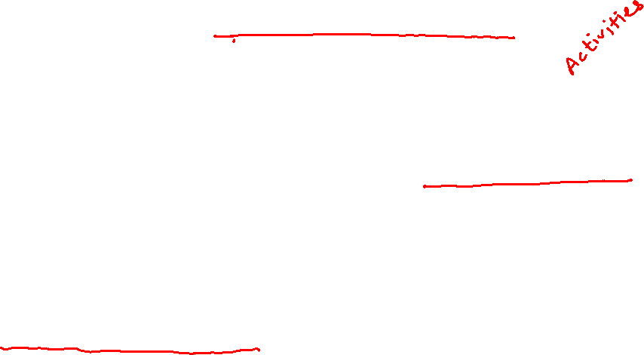
Developing an Activity Diagram
Describes how activities are coordinated.
Is particularly useful when you know that an operation has to achieve a number of different things, and you want to model what the essential dependencies between them are, before you decide in what order to do them.
Record the dependencies between activities, such as which things can happen in parallel and what must be finished before something else can start.
Represents the workflow of the process.

Slide 5

Notation
2. Transition
Activity1()
Activity2()
1. Activities

Slide 6
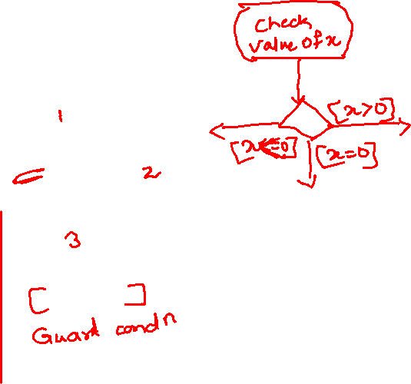
Notation - 2
[x>0]
[x>0]
Activity1()
[x=0]
[x=0]
[x<0]
[x<0]
3. Decision Diamond

Slide 7
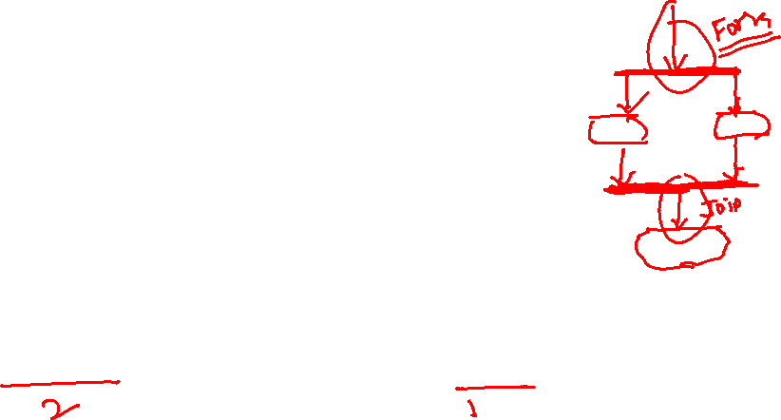
Notation - 3
4.1 Synch. Bar (Join)
4.2 Splitting Bar (Fork)

Slide 8
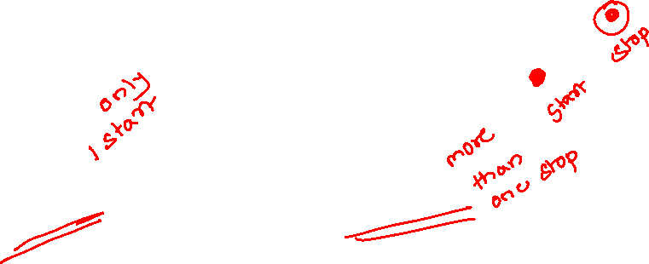
Notation - 3
Start Marker
Stop Marker
5. Start & Stop Markers

Slide 9
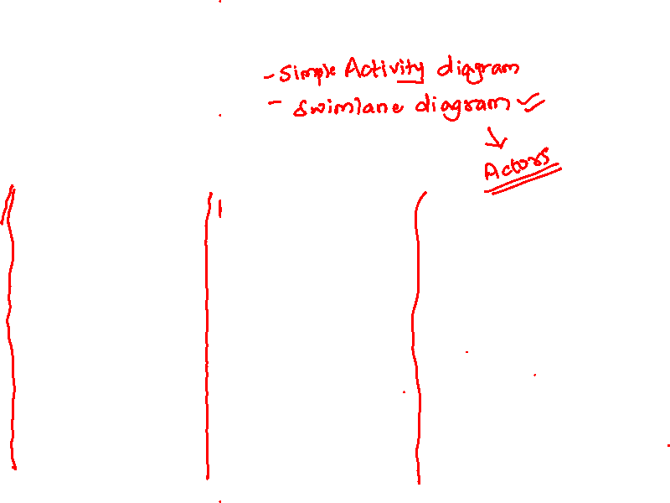
Notation - 4
Developers
Testers
Markers
Swimlane
Swimlane
Swimlane
Application/Department/Group/Role Boundaries

Slide 10
Activity Diagrams
Activity diagrams commonly contain
Activity states and action states
Transitions
Objects

Slide 11
Action States and Activity States
Action states are atomic and cannot be decomposed
Work of the action state is not interrupted
Activity states can be further decomposed
Their activity being represented by other activity diagrams
They may be interrupted

Slide 12

Transitions
When the action or activity of a state completes, flow of control passes immediately to the next action or activity state
A flow of control has to start and end someplace
initial state -- a solid ball
stop state -- a solid ball inside a circle

Slide 13
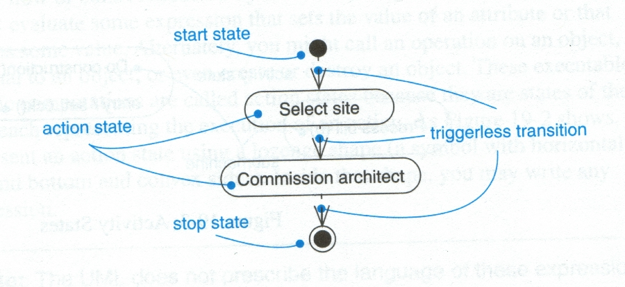
Transitions

Slide 14
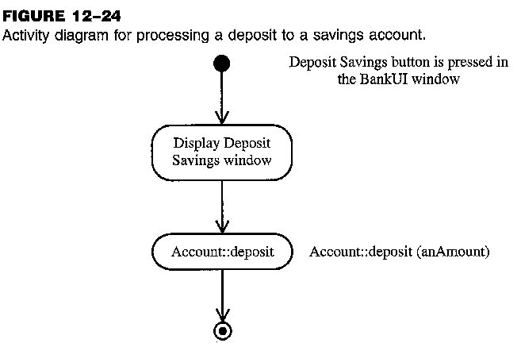

Activity Diagram: Example (1)

Slide 15
Branching
A branch specifies alternate paths taken based on some Boolean expression
A branch may have one incoming transition and two or more outgoing ones

Slide 16
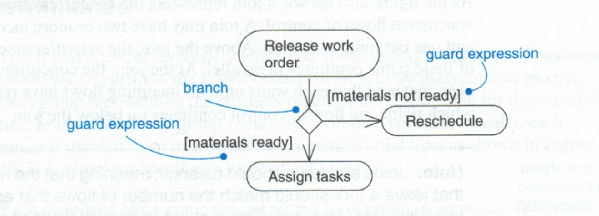
Branching

Slide 17
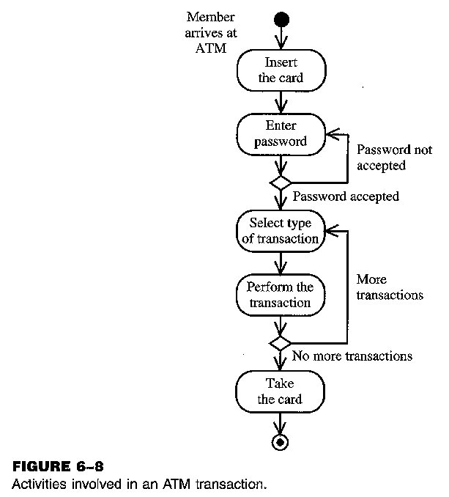
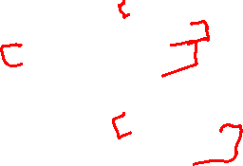
Activity Diagram: Example

Slide 18
Forking and Joining
Use a synchronization bar to specify the forking and joining of parallel flows of control
A synchronization bar is rendered as a thick horizontal or vertical line

Slide 19
Fork
A fork may have one incoming transitions and two or more outgoing transitions
each transition represents an independent flow of control
conceptually, the activities of each of outgoing transitions are concurrent
either truly concurrent (multiple nodes)
or sequential yet interleaved (one node)

Slide 20
Join
A join may have two or more incoming transitions and one outgoing transition
above the join, the activities associated with each of these paths continues in parallel
at the join, the concurrent flows synchronize
each waits until all incoming flows have reached the join, at which point one flow of control continues on below the join

Slide 21
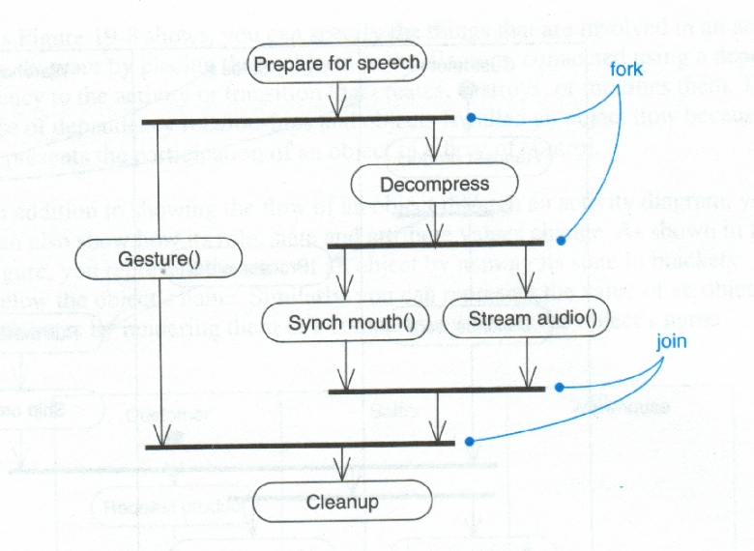

Fork and Join Example

Slide 22
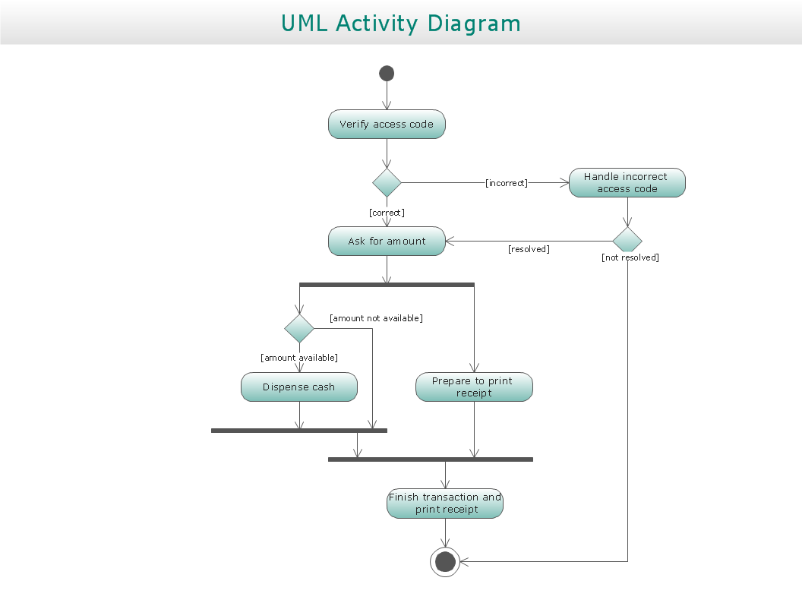


Slide 23
Revision: Activity Diagram
Rounded rectangle → actions.
Diamond → decisions/merge
Bars → The start (fork) or end (join) of concurrent activities.
Black circle → start (initial state)
Encircled black →end (final state)
Arrow → flow of control

Slide 24
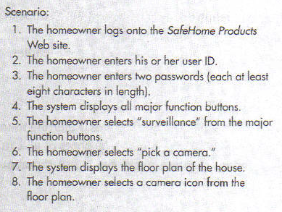
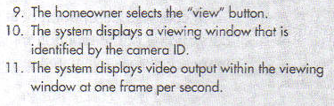
Example on Activity Diagram
.

Slide 25
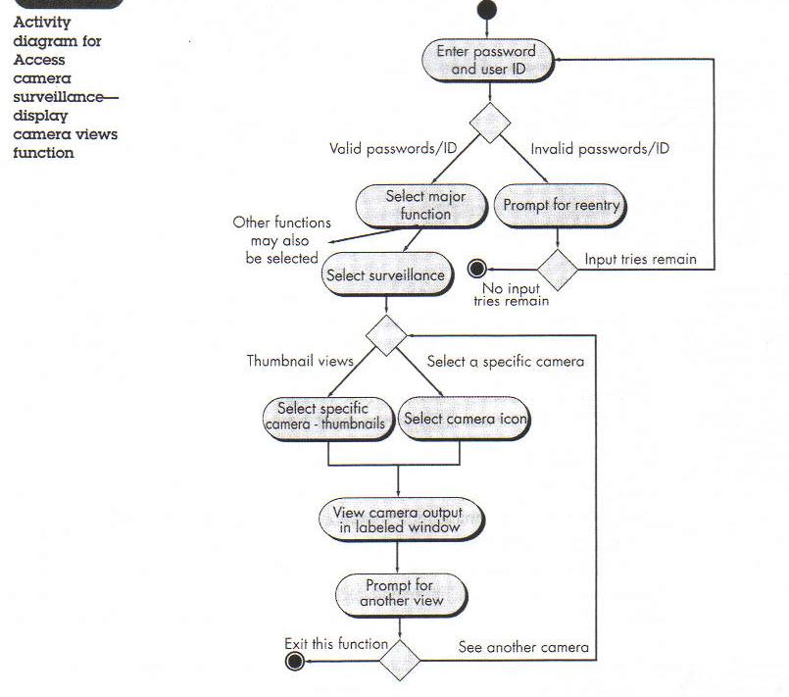

Activity Diagram

Slide 26
Swimlane Diagrams
A variation of activity diagram
Indicate which actor has responsibility for the action described by an activity rectangle
A UML swimlane diagram represents the flow of actions, decisions and indicates which actors perform each

Slide 27
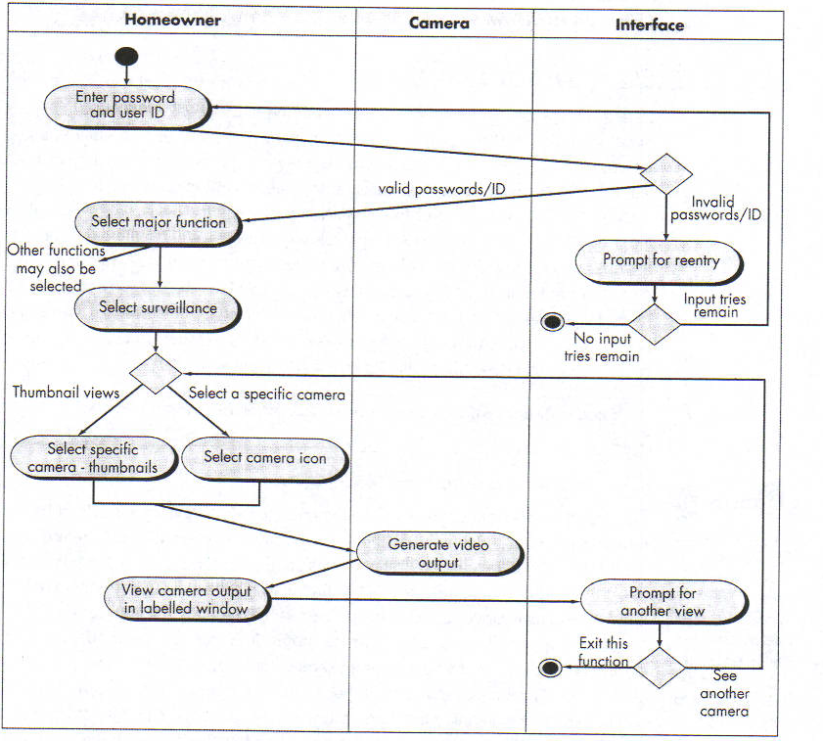

Swimlane Diagrams

Slide 28
Facebook is an online social media website, where the users must register before using the it. Once the user is authenticated by site, he can retrieve notifications, messages and requests. Further, in the next step the user can change the user preferences as online or hidden. Finally the status will be displayed in user’s wall. User has option to login by entering credentials for three times. Third unsuccessful login will lock the account, send warning email of the user and display ‘account locker’ message on the screen. Else the system will prompt for login credentials again.

Slide 29
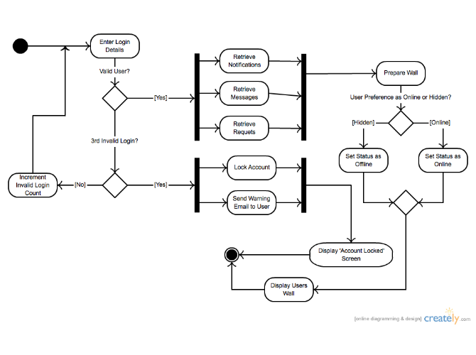
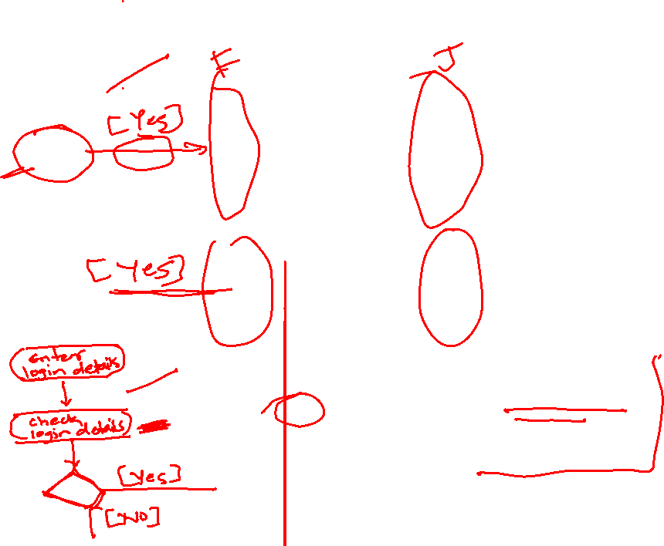

Slide 30
Swimlanes (1)
A swimlane specifies a locus of activities
To partition the activity states on an activity diagram into groups
each group representing the business organization responsible for those activities
each group is called a swimlane
Each swimlane is divided from its neighbor by a vertical solid line

Slide 31

Swimlanes (2)
Each swimlane has a name unique within its diagram
Each swimlane may represent some real-world entity
Each swimlane may be implemented by one or more classes
Every activity belongs to exactly one swimlane, but transitions may cross lanes

Slide 32
Activity Diagram for Receiving an Order
Receive
order
* for each line
item on order
Authorise
Payment
Check line
item
[failed]
[in stock]
Cancel
Order
[succeeded]
Assign
to Order
[need to reorder]
Reorder
item
[stock assigned
to all line items
and payment
authorised]
Dispatch
Order

Slide 33
Activity Diagram for receiving Supply
Receive
Supply
Choose outstanding
order items
* for each chosen order item
Assign goods
to order
[all outstanding order items filled]
Add remainder
to stock
Dispatch
Order

Slide 34
Combined Activity Diagram
Receive
order
Receive
Supply
* for each line
item on order
Choose
outstanding
order items
Check line
item
Authorise
Payment
[failed]
[in stock]
* for each chosen order item
[succeeded]
Assign
to Order
Assign goods
to order
Cancel
Order
[need to reorder]
Reorder
item
[stock assigned
to all line items
and payment
authorised]
[all outstanding order items filled]
Dispatch
Order
Add remainder
to stock

Slide 35
With Swimlanes
Finance
Order
Processing
Stock
Manager
Receive
order
Receive
Supply
* for each line
item on order
Choose
outstanding
order items
Check line
item
Authorise
Payment
[failed]
[in stock]
* for each chosen order item
[succeeded]
Assign
to Order
Assign goods
to order
Cancel
Order
[need to reorder]
Reorder
item
[stock assigned
to all line items
and payment
authorised]
[all outstanding order items filled]
Dispatch
Order
Add remainder
to stock

Slide 36
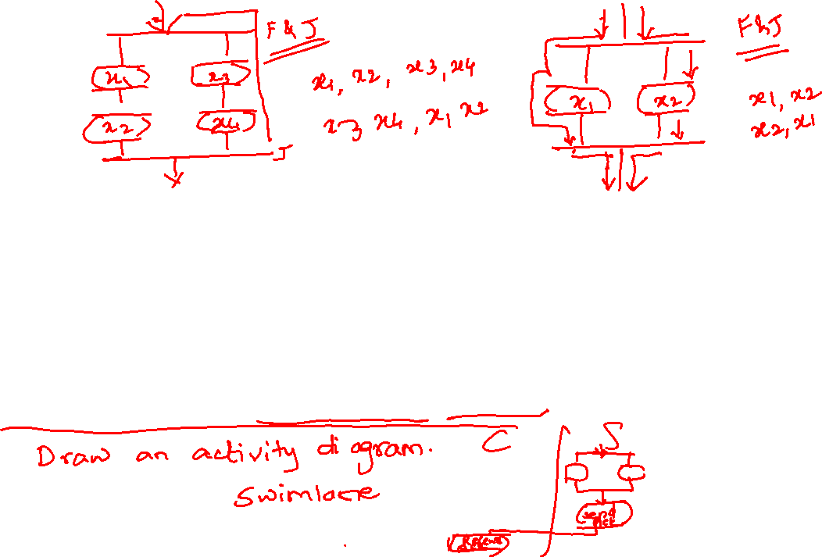

The client needs to know the whole address of a server for the communication. Client performs some work which includes, making a decision to initiate a connection to a server. If connection to the server fails, or the server rejects the connection, the client may try again or may give up. On successful connection, the client reads the request to execute the services. GET_OS and GET_IP are the services which will execute parallel and acknowledgement will be sent to the client by the server.

Slide 37
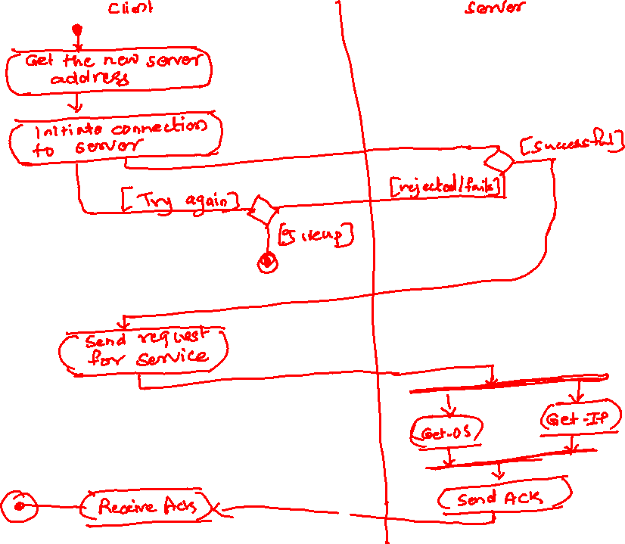


Slide 38
The ATM will service one customer at a time. A customer will be required to insert an ATM card and enter a personal identification number (PIN) - both of which will be sent to the bank for validation as part of each transaction. The customer will then be able to perform one or more transactions.
The card will be retained in the machine until the customer indicates that he/she desires no further transactions, at which point it will be returned. The ATM will communicate each transaction to the bank and obtain verification that it was allowed by the bank. If the bank determines that the customer's PIN is invalid, the customer will be required to re-enter the PIN before a transaction can proceed.
If the customer is unable to successfully enter the PIN after three tries, the card will be permanently retained by the machine, and the customer will have to contact the bank to get it back. If a transaction fails for any reason other than an invalid PIN, the ATM will display an explanation of the problem, and will then ask the customer whether he/she wants to do another transaction.

Slide 39
The ATM will also maintain an internal log of transactions to facilitate resolving ambiguities arising from a hardware failure in the middle of a transaction. Entries will be made in the log when the ATM is started up and shut down, for each message sent to the Bank (along with the response back, if one is expected), for the dispensing of cash, and for the receiving of an envelope.
Log entries may contain card numbers and amounts, but for security will never contain a PIN. To avail ATM facility, a customer is required to open/have an account in the bank and apply for the ATM card. A customer can have one or more accounts and for each account, only one ATM card will be provided.
The bank also provides SMS updates for every transaction of customer’s account. To obtain SMS updates, customer is required to register his/her mobile number against his account in the bank.

